Slide 1
Design and Implementation of an Anonymous, Verifiable, and Time-Bound Data System using Hash Functions, Digital Signatures, and Public Key Cryptography
Cryptography and Network Security – BCSE309L
Faculty: Dr. N G Bhuvaneswari
Team Members:
Biswadeep Dawn – 23BCE1024
Rahul Dutta – 23BCE1250

Slide 2
Project Overview
This project proposes a cryptographic system that allows users to submit sensitive data anonymously, ensures that the data’s existence can be verified, and guarantees that the data is automatically destroyed after a fixed time using cryptography.
The system ensures:
No identity is stored
No plaintext is stored on the server
Data can be proven to exist
Data becomes unrecoverable after expiry
This makes it suitable for:
Anonymous feedback systems
Whistleblowing platforms
Secure academic submissions
Confidential reporting

Slide 3
Introduction
In today’s digital systems, sensitive information such as feedback, complaints, exam submissions, and reports are stored for long periods, creating serious privacy and security risks.
Even when encryption is used:
Administrators can access decrypted data
Data remains recoverable forever
Users must reveal identity for authenticity
Our project focuses on cryptographic trust, where privacy, authenticity, and data expiry are enforced mathematically, not administratively.

Slide 4
Problem Statement
Current digital systems suffer from three major security problems:
No true anonymity
Users must reveal identity to prove authenticity.
No cryptographic proof of existence
Systems cannot prove that data existed at a given time without storing the data itself.
No guaranteed data deletion
Even after purpose is served, encrypted data remains recoverable.
There is no unified system that supports anonymous submission, verifiable data existence, and cryptographic data expiry.

Slide 5
Objectives
The objectives of this project are:
To allow users to submit data anonymously but authentically
To generate cryptographic proof-of-existence for each submission
To store only encrypted data on the server
To ensure that data becomes irrecoverable after expiry
To prevent misuse by administrators or attackers
To ensure zero-trust server architecture

Slide 6
Proposed Solution
We propose a cryptographic lifecycle framework that manages data from creation to destruction using security algorithms.
Key technologies used:
AES for data encryption
RSA-OAEP for secure key protection
SHA-256 for hashing and proof-of-existence
Digital Signatures for integrity and authenticity
Time-based key destruction for irreversible data expiry
The server never sees:
User identity
Plaintext data
Usable encryption keys after expiry

Slide 7
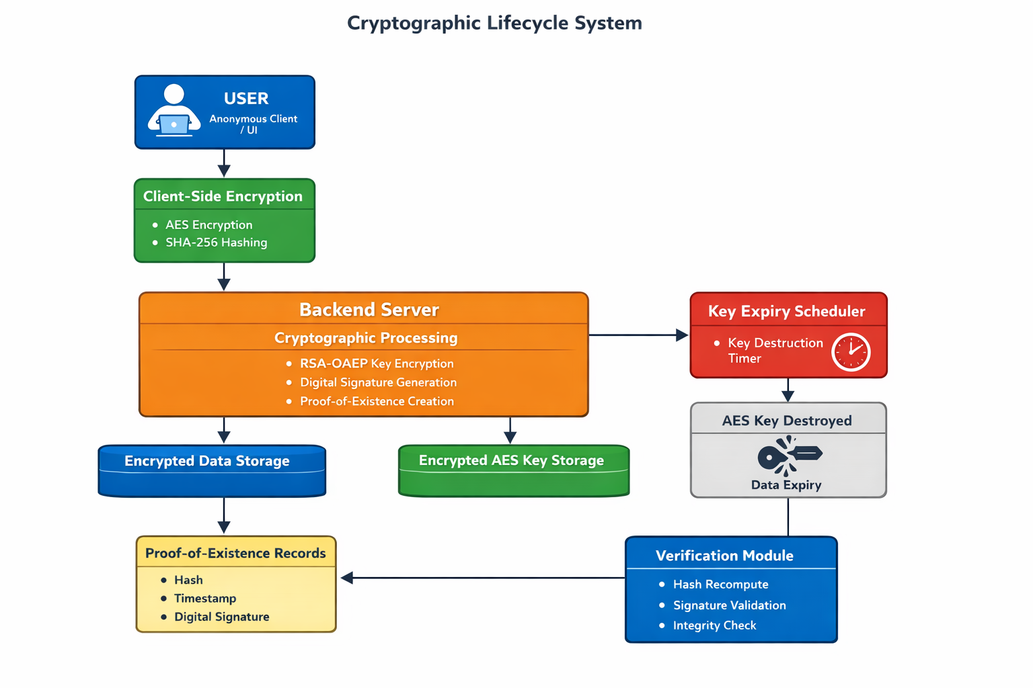
System Architecture
Layers:
User Layer – submits data anonymously
Client Encryption Layer – encrypts data using AES
Backend Cryptographic Layer – protects keys using RSA and signs hashes
Temporary Storage Layer – stores encrypted data and encrypted keys
Key Expiry Scheduler – destroys AES keys after expiry
Verification Layer – verifies proof-of-existence

Slide 8
How the System Works
User submits data anonymously
Data is encrypted using AES
AES key is encrypted using RSA
Server generates hash + timestamp + digital signature
Encrypted data and encrypted key are stored
Scheduler destroys AES key after expiry
Data becomes permanently unreadable
Proof can still be verified using hash and signature

Slide 9
Applications
This system can be used for:
Anonymous student feedback
Whistleblower platforms
Secure complaint systems
Exam submissions
Legal document submission
Research paper timestamping

Slide 10
Related Works
Emura et al. (2017): Proposes a new security model for group signatures with time-bound keys and an efficient construction with practical implementation.
Thyagarajan et al. (2020): Presents practical verifiable timed signatures enabling time-specific verifiability without trusted setups."
Bao et al. (2023): Introduces constant-size verifiable timed signatures from RSA groups, optimized for Bitcoin-based voting.
Nie et al. (2022): Enables time-controlled verifiable secure search over blockchain-shared electronic health records in IoT.
Yu et al. (2023): Develops VeriAnon, using ring signatures and clustering Merkle trees for anonymous, verifiable decentralized commenting.

Slide 11
Summary
We designed a system that ensures:
Anonymous data submission
Verifiable proof of data existence
Automatic cryptographic data expiry
Zero trust in server administrators
This provides privacy, trust, and security in a single cryptographic framework.

Slide 12
References
Emura, K., Hayashi, T., & Ishida, A. (2017). Group signatures with time-bound keys revisited: a new model, an efficient construction, and its implementation. IEEE Transactions on Dependable and Secure Computing, 17(2), 292-305.
Thyagarajan, S. A. K., Bhat, A., Malavolta, G., Döttling, N., Kate, A., & Schröder, D. (2020, October). Verifiable timed signatures made practical. In Proceedings of the 2020 ACM SIGSAC conference on computer and communications security (pp. 1733-1750).
Bao, Z., He, D., Feng, Q., Luo, M., & Zeng, X. (2023). Constant-size verifiable timed signatures from RSA group for Bitcoin-based voting protocols. IEEE Transactions on Services Computing, 17(4), 1414-1425.
Nie, X., Zhang, A., Chen, J., Qu, Y., & Yu, S. (2022). Time‐enabled and verifiable secure search for blockchain‐empowered electronic health record sharing in IoT. Security and Communication Networks, 2022(1), 1103863.
Yu, J., Guo, Y., Ding, Y., & Sato, H. (2023, October). VeriAnon: an Anonymous, Verifiable, and Tamper-proof Commenting System Based on Ring Signature and Clustering Merkle Tree for Decentralized Trading. In Proceedings of the 2023 4th Asia Service Sciences and Software Engineering Conference (pp. 132-140).

Slide 13
Thank You

